Slide 1

From Problem to Approach

Slide 2
Objectives
Understand business understanding
Understand analytic approach
Data Science Methodology

Slide 3
Business Understanding
Think about the following situation: you meet your boss, and you are given a task with a clear deadline. By your ability to evaluate, you and your boss have identified apparent problems and the ability to complete the task before the deadline. However, when you leave, you again review the request and see that many issues need clarification, which is quite important. But your boss certainly won't give you extra time to discuss it with you➔ What will you do?
Give your opinion!
Data Science Methodology

Slide 4
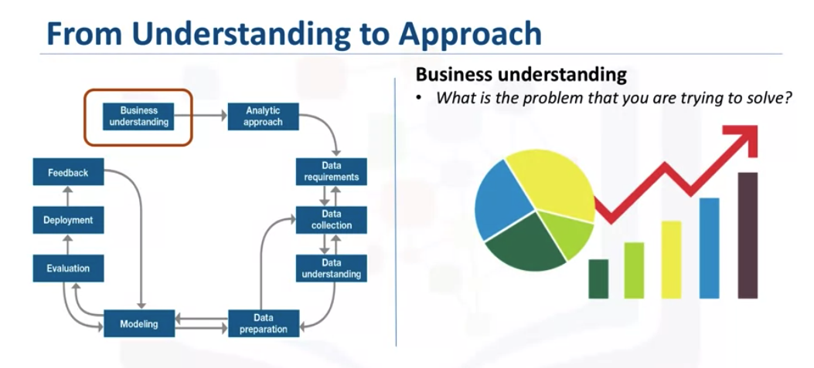
Business Understanding
Data Science Methodology

Slide 5
Business Understanding
Data science methodology begins with spending the time to seek clarification, to attain what can be referred to as a business understanding.
Having this understanding is placed at the beginning of the methodology because getting clarity around the problem to be solved, allows you to determine which data will be used to answer the core question.
Having a clearly defined question is vital because it ultimately directs the analytic approach that will be needed to address the question.
Establishing a clearly defined question starts with understanding the GOAL of the person who is asking the question.
Data Science Methodology

Slide 6
Business Understanding
Understanding the objective is very important in choosing the data science methodology.
Once the goal is clarified, the next piece of the puzzle is to figure out the objectives that are in support of the goal.
Depending on the problem, different stakeholders will need to be engaged in the discussion to help determine requirements and clarify questions.
Data Science Methodology

Slide 7
Business Understanding
Let's analyze the following example to see the importance of Business understanding. The question being asked is: What is the best way to allocate the limited healthcare budget to maximize its use in providing quality care?
This question is one that became a hot topic for an American healthcare insurance provider.
As public funding for readmissions was decreasing, this insurance company was at risk of having to make up for the cost difference, which could potentially increase rates for its customers.
What is your solutions ?
Data Science Methodology

Slide 8
Business Understanding
The insurance company sat down with the health care authorities in its region and brought in IBM data scientists to see how data science could be applied to the question at hand.
Before even starting to collect data, the goals and objectives needed to be defined. After spending time to determine the goals and objectives, the team prioritized "patient readmissions" as an effective area for review.
→ It was found that approximately 30% of individuals who finish rehab treatment would be readmitted to a rehab center within one year; and that 50% would be readmitted within five years.
Data Science Methodology

Slide 9
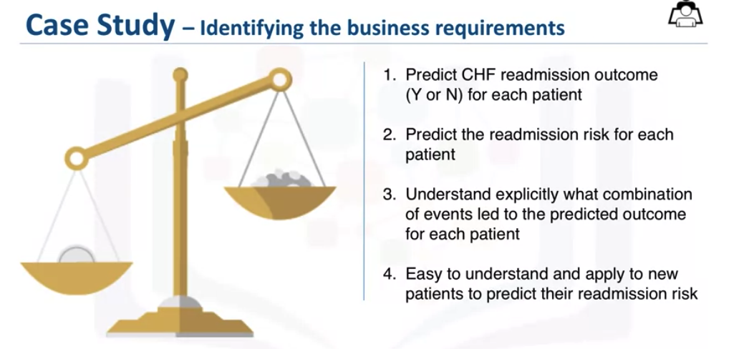
Business Understanding
Data Science Methodology

Slide 10
Analytic Approach
Selecting the right analytic approach depends on the question being asked.
The approach involves seeking clarification from the person who is asking the question, so as to be able to pick the most appropriate path or approach.
This is the second stage of the data science methodology. Once a strong understanding of the question is established, the analytic approach can be selected.
This means identifying what type of patterns will be needed to address the question most effectively.
Data Science Methodology

Slide 11
Analytic Approach
If the question is to determine the probabilities of an action, then a predictive model might be used.
If the question is to show relationships, a descriptive approach maybe be required.
Statistical analysis applies to problems that require counts.
If the question requires a yes/ no answer, then a classification approach to predicting a response would be suitable.
Machine Learning can be used to identify relationships and trends in data that might otherwise not be accessible or identified.
Data Science Methodology

Slide 12
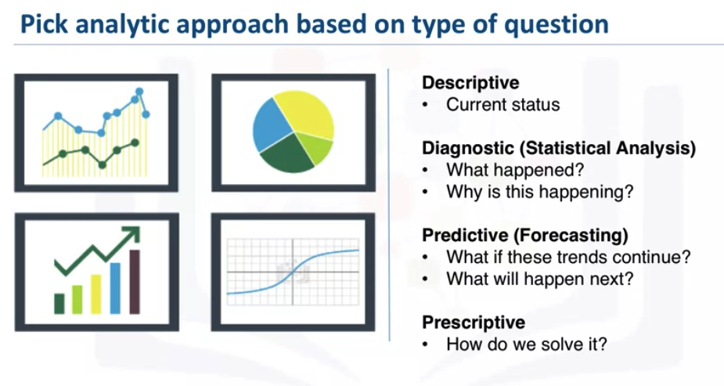
Analytic Approach
Data Science Methodology

Slide 13
Analytic Approach
In the case where the question is to learn about human behaviour, then an appropriate response would be to use Clustering Association approaches.
For the case study, a decision tree classification model was used to identify the combination of conditions leading to each patient's outcome.
A decision tree classification model is easy for non-data scientists to understand and apply, to score new patients for their risk of readmission. Clinicians can readily see what conditions are causing a patient to be scored as high-risk and multiple models can be built and applied at various points during hospital stay.
Data Science Methodology

Slide 14
Analytic Approach
A decision tree classification model gives a moving picture of the patient's risk and how it is evolving with the various treatments being applied.
For these reasons, the decision tree classification approach was chosen for building the Congestive Heart Failure readmission model.
Data Science Methodology

Slide 15
Summary
Understand business understanding
Understand analytic approach
Data Science Methodology

Slide 16
Q & A
Data Science Methodology

